Slide 1



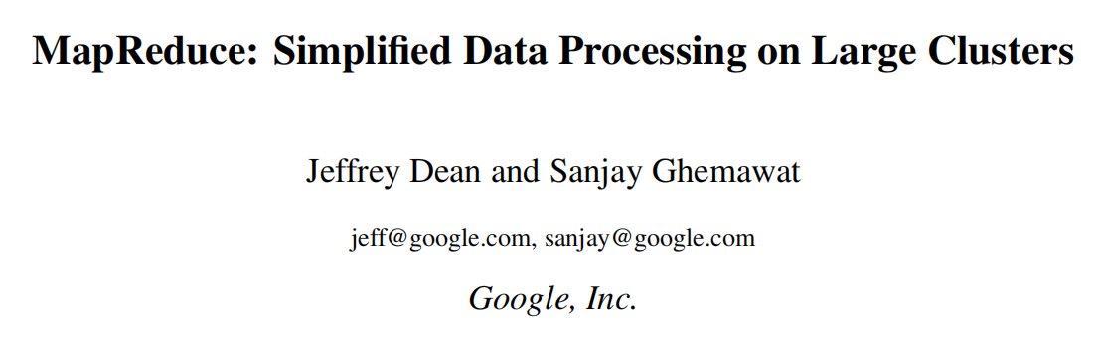

50015627 JIANG Zhuoyang
HKUST (GZ) INFORMATION HUB: DSAA 5021 Nov.28 2023
Notes:
Good morning everyone, I’m JZY
it's a pleasure to share this paper with you.
It is about One of the most three important work of Google about BIG DATA
--MapReduce

Slide 2

Outline
0. Motivation and Cross-the-threshold
1. Part 1: Exploring Commonalities - Programming Models
2. Part 2: Establishing Systematicity - Framework
3. Part 3: Availability and Robustness- Implementation and Refinements
4. Validation and Inspiration
Notes:
I’d like to talk about my motivation when I choose to pre this paper first
Then I will divide it into 3 parts to talk about this paper

Slide 3
0. Motivation and Cross-the-threshold
Notes:
First, let’s begin with the problem

Slide 4
Motivation and Cross-the-threshold
Why is it difficult to enter a paper for me? Facing various solutions directly from the beginning, not understanding the background of the problem, and unclear goals for reading such a paper!
How to cross the threshold? Finding a goal: mainly and firstly refine advanced thinking, not just familiarize oneself with detailed techniques.
system
Framework:
Input, Method, Output
Implementation:
operation, storage, control
Requirements:
Virtual, concurrent, Persistent
Part 1
Part 2
Part 3
Large scale demand
Basic efficiency rules
Problem-Solution mode
Availability optimization
Exploring commonalities
Basic framework
Specific implementation
Other Skills
Notes:
I have always had difficulty accessing articles related to systems,
and I want to conquer this and firstly I have to ask myself why?
I think that may because ...
So I ...
I call back some important things about system, they are
Then I sorted out the overall logic starting from the background of the article and will unfold it in sequence
...

Slide 5
Part 1: Exploring Commonalities - Programming Models
Notes:
We first explore how to construct excellent input domains from data to features

Slide 6
1.1 Commonalities of the problem
Large scale demand
Context
Commonalities
Management
Big-data task
Key-value data
Map: Divide-Conquer
Task of google
Divide-Conquer-Merge
Reduce: Conquer-Merge
Problem | Key | Value | Map | Reduce
WordFrequency Statistics for large-scale multi file systems | docname -> word | doc contents -> counts | emits word with count get <word,count> | sums together get <word,count_sum>
Distributed Grep Match | docname ->pattern | doc contents -> matched lines | emits matched pattern line get <pattern,matched lines> | copies intermediate data to output get <pattern,list(matched lines)>
Reverse Web-Link Graph | source pagename ->link target | page content ->sourse list | emits link-in-sourse to target get <target, source> pairs | sums together : get <target, list(source)> pairs
Distributed Sort | record_id -> target key | record content ->record | extracts key from each record get <key, record> pairs | emits all pairs unchanged
Statistics
Match
Reverse
Sort
URL Access Frequency
Annual max temperature
Distributed Grep
Reverse Web-Link Graph
Inverted Index
Distributed Sort
CANNOT SOLVE-Algorithm Recursively(e.g.The Fibonacci sequence): the next result depends on the previous result
CANNOT SOLVE-Hierarchical clustering: Merging by distance, the distance between each two objects needs to be calculated.
Notes:
Behind a Large scale demand in GOOGLE’S Tasks
There must be some Commonalities of lots of problems
For instance, we have problems like Statistics/Match/Reverse or Sort,
Their data has the similar characteristic--THE key-value Form
And can be Divide-Conquer-Merge
So the MAP-REDUCE IS ABOUT Key-value data and Divide-Conquer-Merge
It is worth noting that MR cannot model all types of problems either
like Algorithm Recursively or Hierarchical clustering

Slide 7
1.1 Commonalities of the problem
Context
Commonalities
Management
Big-data task
Divide-Conquer-Merge
Map: Divide-Conquer
Task of google
Key-value data
Reduce: Conquer-Merge
Big roblems
decomposed
into many
Relatively Independent
Sub Problems
processed in parallel
Result Convergence
big problems have also been solved
Divide-Conque-Merge
Original (Key,Value) s
Map
(TargetKey,Task-Value)
Reduce
(TargetKey,list)
(TargetKey,sum)
Deal with <key,value> data
Notes:
More specifically,
Divide and conque means we decomposed Big roblems into many Relatively Independent Sub Problems
processed them in parallel
after that big problems has been also solved
This is achieved through the processing of key value pairs

Slide 8
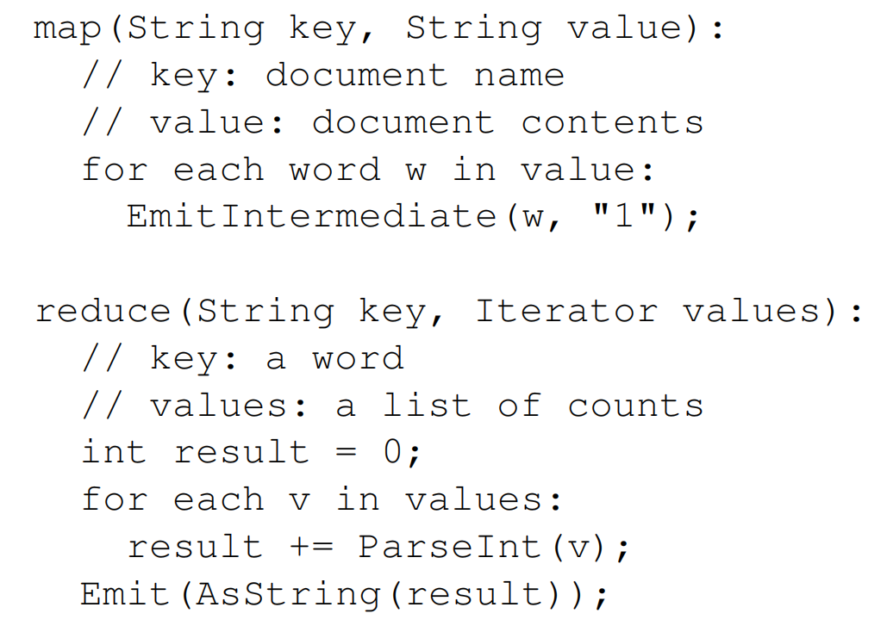
1.2 Programming Models
Problem | WordFrequency Statistics for large-scale multi file systems
Key | docname -> word
Value | doc contents -> counts
Map | emits word with count get <word,count>
Reduce | sums together get <word,count_sum>
Original (Key,Value) s
Map
(TargetKey,Task-Value)
Reduce
(TargetKey,list)
(TargetKey,sum)
Deal with <key,value> data
Notes:
Let's take a specific example
when do Statistics of WordFrequency for large-scale multi file systems
The Original (Key,Value) is...
it can be used to divide
Than MAP get (word, count)pair
and REDUCE get sum of word frequncy
they are used to conquer

Slide 9
Part 2: Establishing Systematicity - Framework
Notes:
Then we can use some Basic efficiency rules to construct the Framework

Slide 10
2.1. Establishing Systematicity
Input
Domain
Map
Domain
Medium
Domain
Reduce
Domain
Output Domain
Data-Split
Map
Operation
Remote read
Data-Store
Disk
Task Domain
Program-folk
Local write
Manage
Reduce
Operation
Program-end
read
instruct
assign map
Master
Local-write instruct
assign reduce
Master
write
instruct
Control Domain
Remote-read instruct
Execute Domain
(k1,v1)_1
map₁(k1,v1)
list(k2,v2)_1
redu₁(k2,list(v2))
list(v2)_1
(k1,v1)_2
map₂(k1,v1)
list(k2,v2)_2
redu₂(k2,list(v2))
list(v2)_2
Workers
K-V process
...
...
...
...
...
(k1,v1)_a
map_{b}(k1,v1)
list(k2,v2)_b
redu_{c}(k2,list(v2))
list(v2)_c
Memory Domain
GFS
M-Worker
->Local-Disk
Disks
Some-Disk
->R-Worker
GFS
Basic efficiency rules
Notes:
there are 4 domain we should concern when the task is solving by mapreduce
We can see here

Slide 11
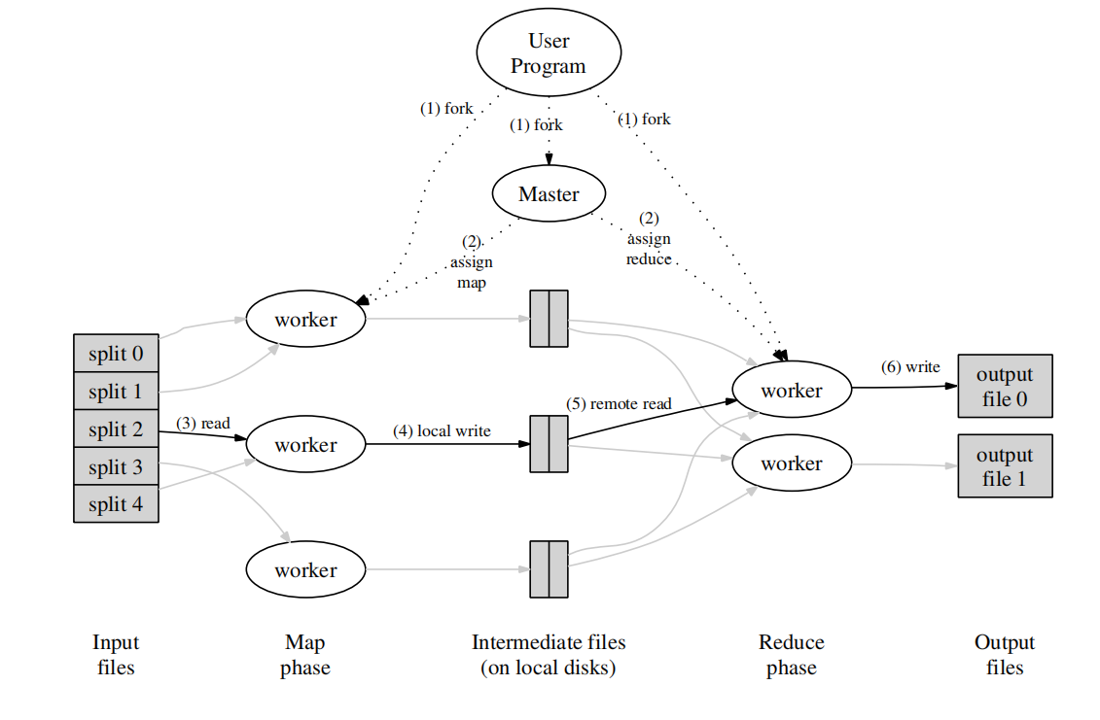
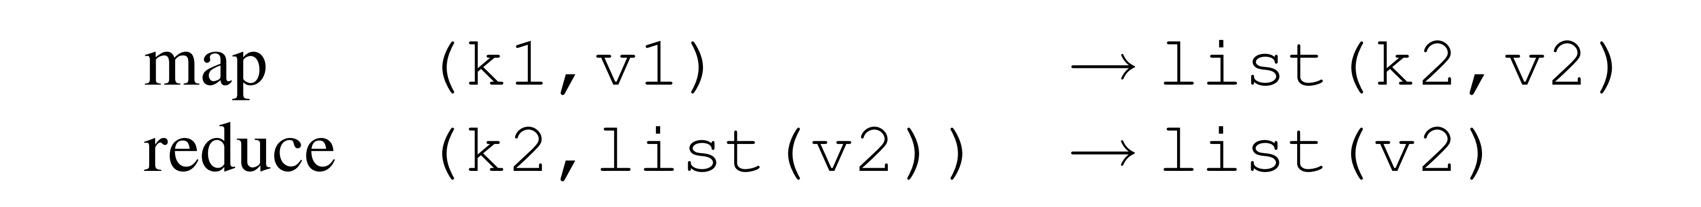
2.2. Framework
Multi-Machine
Multi-Process
HOW MAP-REDUCE DEAL KEY-VALUE
1.Map function:
Accept a key value pair and generate a set of intermediate key value pairs.
2.MapReduce framework:
Pass the middle key value pairs generated by the map function with the same values as the inner keys to a reduce function.
3.Reduce function:
Accept a key and a related set of values, merge these values to produce a smaller set of values (usually only one or zero values).
Notes:
To put it more concretely， firstly...
The most important thing is: HOW MAP-REDUCE USE KEY-VALUE

Slide 12
Part 3: Availability and Robustness- Implementation and Refinements
Notes:
After that framework we need use Problem-Solution mode
do Implementation and Refinement
to reach a system’s Availability and Robustness

Slide 13
3.1. Implementation: Mechanism and Strategy
Problem-Solution mode
Mechanism: What is the solution?
(Choose) Strategy:How to implement the solution?
Master Data Structures
Locations and Sizes of the R intermediate file regions
Control
State (idle, in-progress,or completed)
Identity of the worker machine(for non-idle tasks).
Master Message Management
HTTP status pages
State transition message
Error message
Fault Tolerance
Semantics in the Presence of Failures
Atomic: Complete, Unique -> Transparent as SeqExc
Worker Failure
Master marks the worker as failed and reset idle state
Rescheduling
Message
Master Failure
Write periodic checkpoints of the master DS? Single master, failure unlikely
Aborts
Schedule
Locality Schedule: Map task on/around machine that contains a replica of the corresponding input data
Backup Task Schedule: Close to completion, backup for remaining in-progress tasks(May Be Straggler) (also marked as completed)
Task Granularity Strategy
M: Divided with 16 MB to 64 MB per input data (for locality optimization)
R: small multiple of the number of worker machines expected(By User)
M = 200, 000;R = 5, 000,
2,000 worker machines.
Notes:
when we do the neccersary Implementation
the Mechanism and Strategy is always two important parts
One is about
the other is about
IN Mechanism AREA,we need talk about ...
In STRATAGY AREA, we mainly use Task Granularity Strategy

Slide 14
3.2. Refinements:
Availability optimization
demand: method
Partitioning Function
All entries for a single host to end up in the same output file: hash(Hostname(urlkey)) mod R”
Ordering Guarantees
Support Random access by key: Intermediate key/value pairs are in increasing key order
Combiner Function
Repetition of intermediate keys from map task :Special-Reduce Function for large duplication.
Input and Output Types
For other Input-Type(except string)’s split: Users can add new type by a reader interface
Side-effects
Other files to facilitate subsequent operations: Users guarantee their atomicity and idempotence
Skipping Bad Records
Bug-fix unfeasible (need other library): Detects records caused deterministic crashes and skips
Local Execution
Debugging unfeasible (run on distributed system): Tools for Local debugging or testing
Counters
Sanity check of MapReduce: Creates counter object to count specific tasks or KVpairs
Notes:
What’s more there are the other 8 Refinements can be made decided for the demands
For each refinement, I summarized their "requirements methods" pattern in one sentence

Slide 15
4. Validation and Inspiration
Notes:
Finally, let's take a look at how the author validated these theories
and let me talk about the inspiration I received

Slide 16
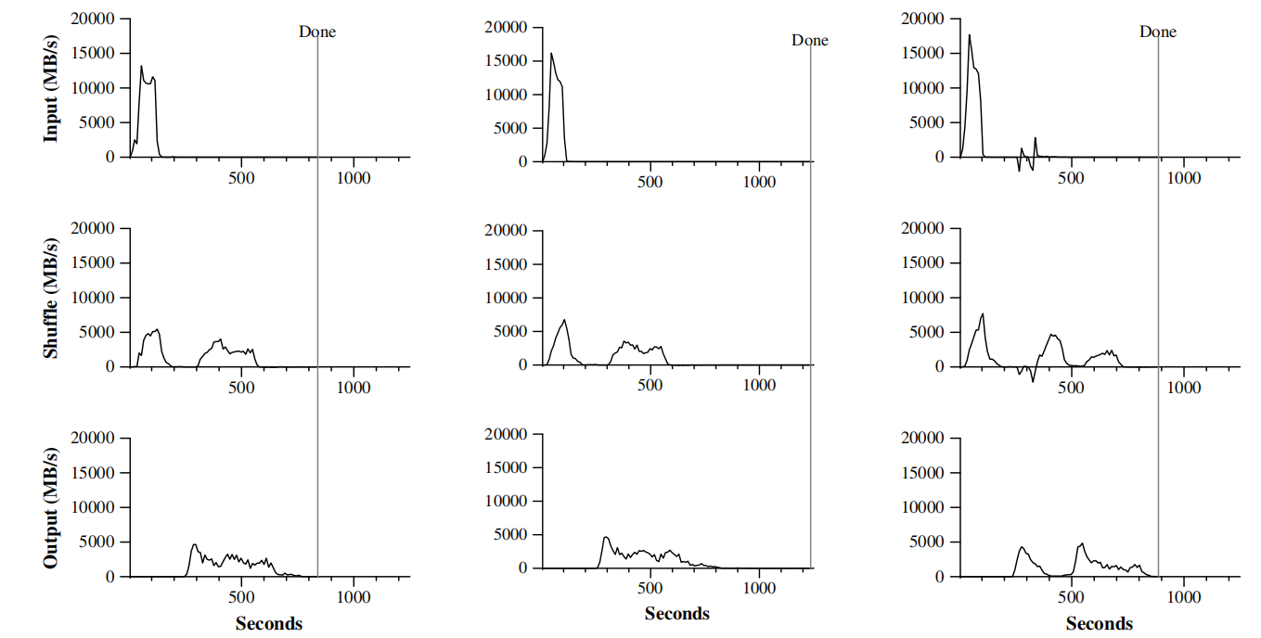
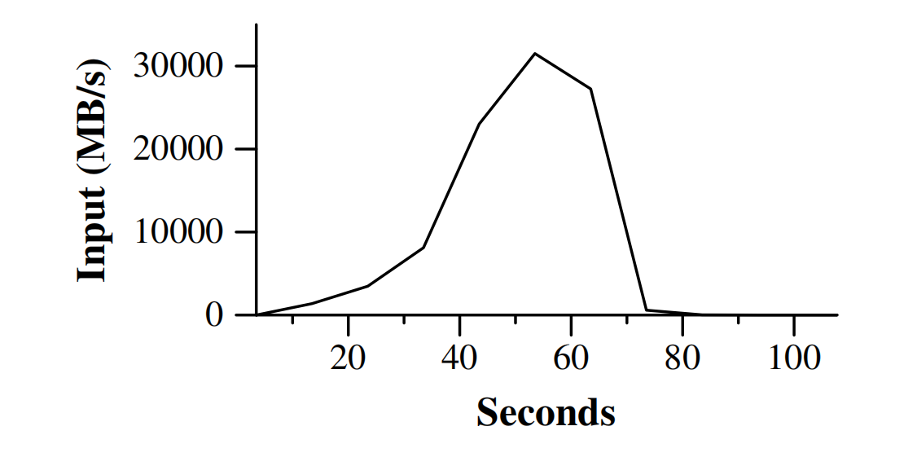
4.1. Performance
Cluster:1800 machines
Each machine:
two 2GHz Intel Xeon
4GB of memory
two 160GB IDE
Network:
1 gigabit Ethernet link
2-level tree-shaped topology
100-200 Gbps at the root
Leaves in same hosting facility
round-trip time ≤ 1 ms
Map
Intermediate Flow
Reduce
GREP Task
Nomal Sort Task
No Backup Sort Task
Sort Task with Failures
Notes:
Firstly, the environment was configured as above
Then, various additional conditions were changed on some baseline tasks
to observe the running effect
It performs normally and well on various tasks

Slide 17
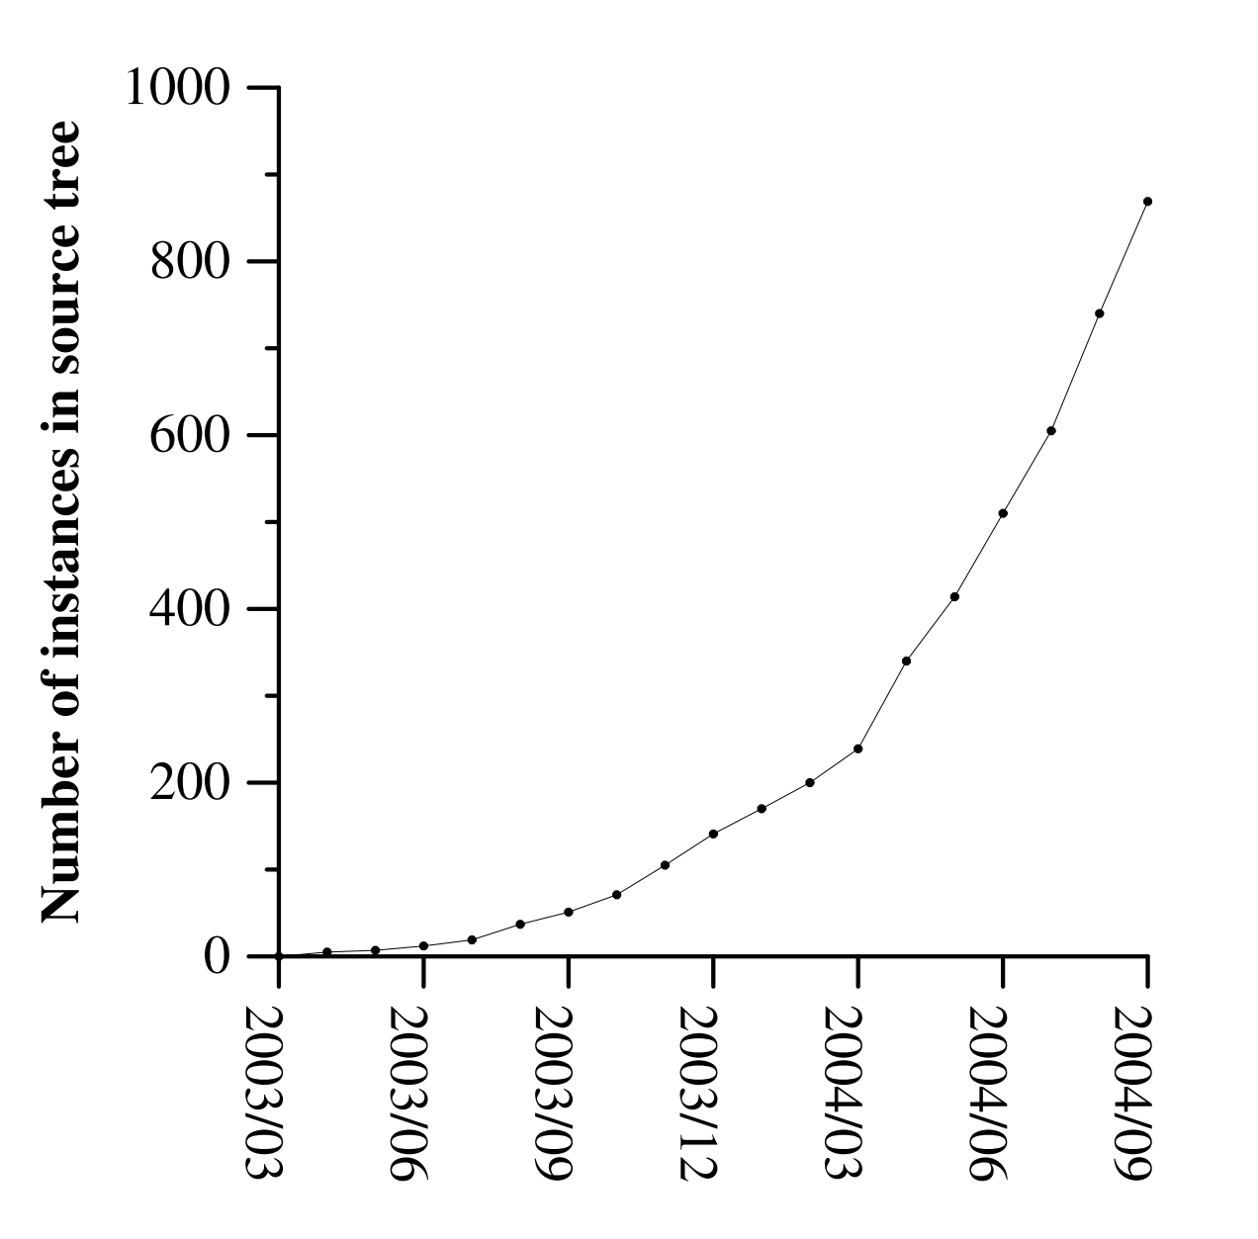
4.2. Application
• large-scale machine learning problems
• clustering problems
(Google News and Froogle products)
• extraction of data used to produce reports of popularqueries
(e.g. Google Zeitgeist)
• extraction of properties of web pages for new exper_x0002_iments and products
(e.g. extraction of geographical locations from a large corpus of web pages for localized search),
• large-scale graph computations
Notes:
MapReduce has been used in diferent data science problems

Slide 18
4.3. Inspiration
system
Framework:
Input, Method, Output
Implementation:
operation, storage, control
Requirements:
Virtual, concurrent, Persistent
Virtualization: Beyond Physics and Transparency
Programming is easy, and developers do not need to master the details of distributed parallel programming. They can easily run their programs on distributed systems and complete massive computations.
Concurrency: divide and conquer
A large-scale dataset stored in a distributed file system will be split into many independent shards, which can be processed in parallel by multiple Map tasks
Persistency: Prevent errors+reduce overhead
The design concept is to "align computing with data", rather than "align data with computing", which reduces a significant amount of network transmission overhead.
Notes:
Let's recall the three types of requirements that need to be met in systematic work
In terms of Virtualization，we need something 。。。 MAPREDUCE CAN
In terms of Concurrency，we need something 。。。 MAPREDUCE CAN
In terms of Persistency，we need something 。。。 MAPREDUCE CAN

Slide 19
The End

